Slide 1
Long Beach, California
Traveling June 8-15 2013
Planned By:
Amber Williams

Slide 2
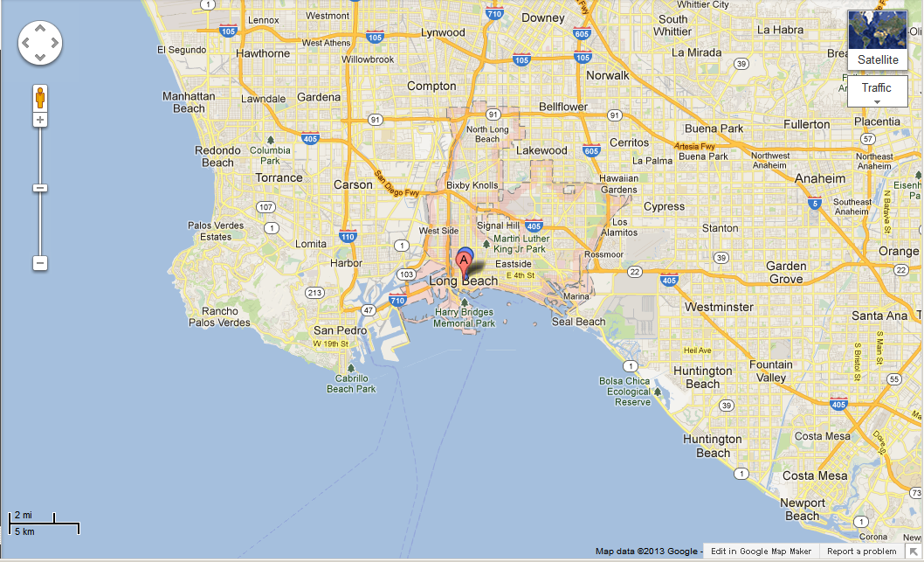
Map

Slide 3
Transportation
Transportation | Budget
Airfare 451x 4 | $1804.00
Airfare Parking at Airport | $50.00
Car Rental | $0.00
Gas (going) [price x 25/ MPG] | $0.00
Gas (coming home) [price x 25/ MPG] | $0.00
Bus Tickets | $0.00
Train | $0.00
Other | $0.00
Total | $0.00
Figure out gas:
Find miles (google Maps)
Divide miles by 25
Take that number x gas price

Slide 4
Lodging
Lodging | Budget
Hotels 151x 6 Holiday Inn Airport Not staying in the same place? Sunday Monday Tuesday Wednesday Thursday Friday Saturday | $906.00
Other | $0.00
Total | $906.00

Slide 5
Extra Expense
Extra expenses | Budget
Souvenirs ($20.00 x 4of people) x 7of purchases | $560.00
Snacks ($10.00 x 4of people) x 7of purchases | $280.00
Emergency cash | $190.00
Total | $1030.00

Slide 6
Itinerary
Total Expense: $668.00
Saturday, June 8th | Where | How Much?
Breakfast | McDonalds $7x4 | $28.00
Activity | Six Flags $65x4 | $260.00
Lunch | Ruby's Diner $15x4 | $60.00
Activity | Six Flags$65x4 | $260.00
Dinner | Ruby's Diner $15x4 | $60.00
Activity |  | $0.00

Slide 7
Itinerary
Total Expense: $668.00
Sunday, June 9th | Where | How Much?
Breakfast | McDonalds$7x4 | $28.00
Activity | Six Flags$65x4 | $240.00
Lunch | Ruby's Diner $15x4 | $60.00
Activity | Six Flags$65x4 | $240.00
Dinner |  | $0.00
Activity |  | $0.00
Sunday, June 9th | Where | How Much?
Breakfast | McDonalds$7x4 | $28.00
Activity | Six Flags$65x4 | $240.00
Lunch | Ruby's Diner $15x4 | $60.00
Activity | Six Flags$65x4 | $240.00
Dinner | Ruby's Diner $15x4 | $60.00
Activity |  | $0.00

Slide 8
Itinerary
Total Expense: $0.00
Monday, June 10th | Where | How Much?
Breakfast | McDonalds$7x4 | $28.00
Activity | Six Flags$65x4 | $240.00
Lunch | Ruby's Diner $15x4 | $60.00
Lunch | Ruby's Diner $15x4 | $60.00
Activity |  | $0.00

Slide 9
Itinerary
Total Expense: $0.00
Tuesday, June 11th | Where | How Much?
Breakfast |  | $0.00
Activity |  | $0.00
Lunch |  | $0.00
Activity |  | $0.00
Dinner |  | $0.00
Activity |  | $0.00

Slide 10
Itinerary
Total Expense: $0.00
Wednesday, June 12th | Where | How Much?
Breakfast |  | $0.00
Activity |  | $0.00
Lunch |  | $0.00
Activity |  | $0.00
Dinner |  | $0.00
Activity |  | $0.00

Slide 11
Itinerary
Total Expense: $0.00
Thursday, June 13th | Where | How Much?
Breakfast |  | $0.00
Activity |  | $0.00
Lunch |  | $0.00
Activity |  | $0.00
Dinner |  | $0.00
Activity |  | $0.00

Slide 12
Itinerary
Total Expense: $0.00
Friday, June 14th | Where | How Much?
Breakfast |  | $0.00
Activity |  | $0.00
Lunch |  | $0.00
Activity |  | $0.00
Dinner |  | $0.00
Activity |  | $0.00

Slide 13
Itinerary
Total Expense: $0.00
Saturday, June 15th | Where | How Much?
Breakfast |  | $0.00
Activity |  | $0.00
Lunch |  | $0.00
Activity |  | $0.00
Dinner |  | $0.00
Activity |  | $0.00

