Slide 1
London,England
Traveling June 8-15 2013
Planned By:
Shaylan Patel

Slide 2
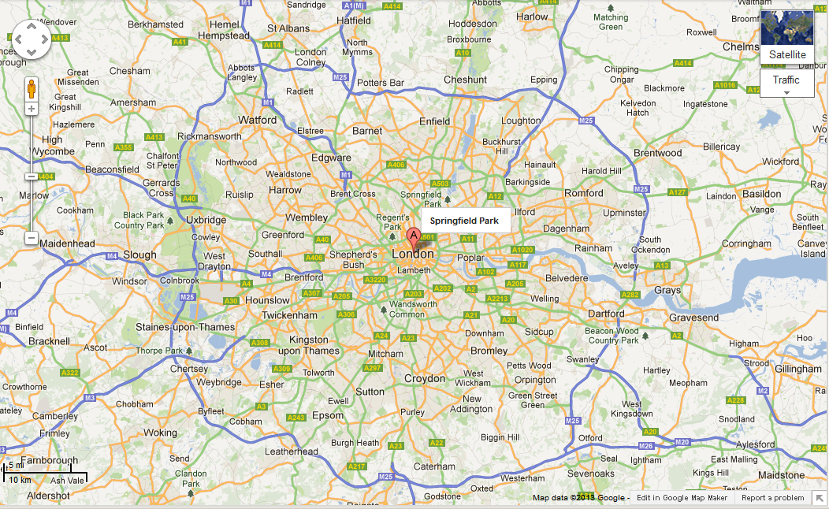
Map

Slide 3
Transportation
Transportation | Budget
Airfare 1378 x 4 | $0.00
Airfare Parking at Airport | $0.00
Car Rental | $0.00
Gas (going) [price x 25/ MPG] | $0.00
Gas (coming home) [price x 25/ MPG] | $0.00
Bus Tickets | $0.00
Train | $0.00
Other | $0.00
Total | $0.00
Figure out gas:
Find miles (google Maps)
Divide miles by 25
Take that number x gas price

Slide 4
Lodging
Lodging | Budget
Hotels $ x how many nights London Marriott Hotel Marble Arch $576 Not staying in the same place? Sunday Monday Tuesday Wednesday Thursday Friday Saturday | $161.28
Other | $0.00
Total | $161.28

Slide 5
Extra Expense
Extra expenses | Budget
Souvenirs ($50.00 x #4of people) x 4of purchases | $800.00
Snacks ($50.00 x 4 of people) x #4of purchases | $800.00
Emergency cash | $200.00
Total | $1800.00

Slide 6
Itinerary
Total Expense: $3052.00
Saturday, June 8th | Where | How Much?
Breakfast | Ihop 13.00x4 | $52.00
Activity | Swimming in the hotel pool | $0.00
Lunch | McDonolds | $28.00
Activity |  | $0.00
Dinner | The Foyer At Claridge's 80x4 | $320.00
Activity |  | $0.00

Slide 7
Itinerary
Total Expense: $0.00
Sunday, June 9th | Where | How Much?
Breakfast | At the hotel | $0.00
Activity | Queen Elizabeth Olympic Park | $68.64
Lunch | At the Olympic park $7x4 | $28.00
Activity |  | $0.00
Dinner |  | $0.00
Activity |  | $0.00

Slide 8
Itinerary
Total Expense: $0.00
Monday, June 10th | Where | How Much?
Breakfast |  | $0.00
Activity |  | $0.00
Lunch |  | $0.00
Activity |  | $0.00
Dinner |  | $0.00
Activity |  | $0.00

Slide 9
Itinerary
Total Expense: $0.00
Tuesday, June 11th | Where | How Much?
Breakfast |  | $0.00
Activity |  | $0.00
Lunch |  | $0.00
Activity |  | $0.00
Dinner |  | $0.00
Activity |  | $0.00

Slide 10
Itinerary
Total Expense: $0.00
Wednesday, June 12th | Where | How Much?
Breakfast |  | $0.00
Activity |  | $0.00
Lunch |  | $0.00
Activity |  | $0.00
Dinner |  | $0.00
Activity |  | $0.00

Slide 11
Itinerary
Total Expense: $0.00
Thursday, June 13th | Where | How Much?
Breakfast |  | $0.00
Activity |  | $0.00
Lunch |  | $0.00
Activity |  | $0.00
Dinner |  | $0.00
Activity |  | $0.00

Slide 12
Itinerary
Total Expense: $0.00
Friday, June 14th | Where | How Much?
Breakfast |  | $0.00
Activity |  | $0.00
Lunch |  | $0.00
Activity |  | $0.00
Dinner |  | $0.00
Activity |  | $0.00

Slide 13
Itinerary
Total Expense: $0.00
Saturday, June 15th | Where | How Much?
Breakfast |  | $0.00
Activity |  | $0.00
Lunch |  | $0.00
Activity |  | $0.00
Dinner |  | $0.00
Activity |  | $0.00

