Slide 1
London, England, United Kingdom
Traveling June 8-15 2013
Planned By:
Simon Bratescu

Slide 2
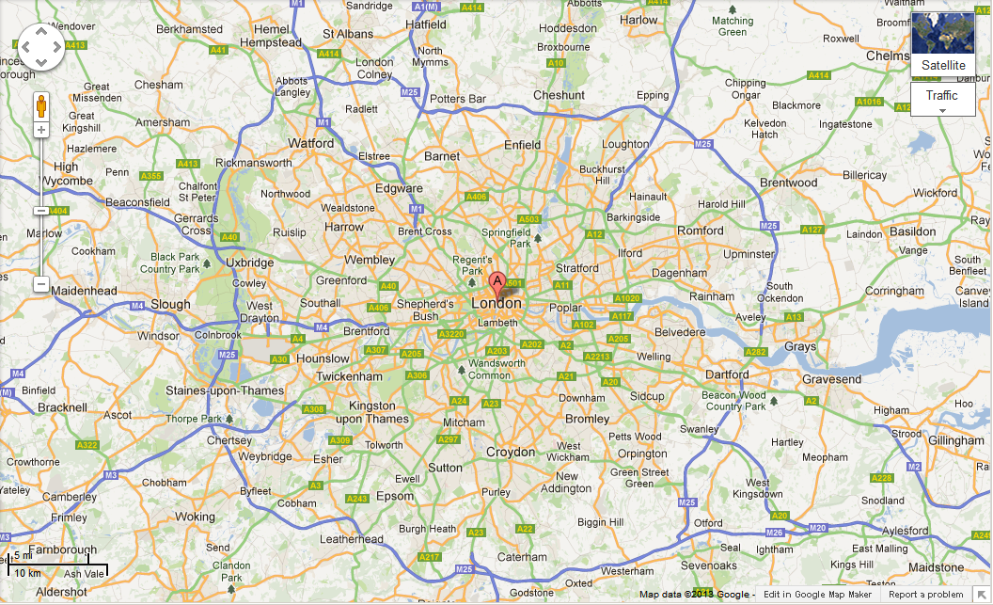
Map

Slide 3
Transportation
Transportation | Budget
Airfare 1585x 5 | $7,925.00
Airfare Parking at Airport | $0.00
Car Rental | $0.00
Gas (going) [price x 25/ MPG] | $0.00
Gas (coming home) [price x 25/ MPG] | $0.00
Bus Tickets | $0.00
Train | $0.00
Other | $0.00
Total | $7,925.00
Figure out gas:
Find miles (google Maps)
Divide miles by 25
Take that number x gas price

Slide 4
Lodging
Lodging | Budget
Hotels $ x how many nights Not staying in the same place? Sunday Monday Tuesday Wednesday Thursday Friday Saturday | $0.00
Other Grandma's housex8free | $0.00
Total | $0.00

Slide 5
Extra Expense
Extra expenses | Budget
Souvenirs ($50.00 x 5 of people) x 7of purchases | $1,750.00
Snacks ($10.00 x 5 of people) x 7 of purchases | $350.00
Emergency cash | $10,000.00
Pass port 140x2 95x3 | 1,125.00
Total | $12,100.00

Slide 6
Itinerary
Total Expense: $1,272.50
Saturday, June 8th | Where | How Much?
Breakfast | Grandma’s 0.00x5 | $0.00
Activity | Scuba diving 250.00x5 | $1,250.00
Lunch | Grandma’s 0.00x5 | $0.00
Activity | Scuba diving | $0
Dinner | Jack's at the Junction 3-5*x5 | $22.50
Activity | Scuba diving 0 | $1,0

Slide 7
Itinerary
Total Expense: $847.50
Sunday, June 9th | Where | How Much?
Breakfast | Grandma’s 0.00x5 | $0.00
Activity | I PILOT Flight Simulator Experience 55.00x5 | $275.00
Lunch | Grandma’s 0.00x5 | $0.00
Activity | I PILOT Flight Simulator Experience | $275.00
Dinner | Jack's at the Junction 3-5*x5 | $22.50
Activity | I PILOT Flight Simulator Experience | $275.00

Slide 8
Itinerary
Total Expense: $22.50
Tuesday, June 11th | Where | How Much?
Breakfast | Grandma’s 0.00x5 | $0.00
Activity | St. James's Park 0.00x5 | $0.00
Lunch | Grandma’s 0.00x5 | $0.00
Activity | St. James's Park 0.00x5 | $0.00
Dinner | Jack's at the Junction 3-5*x5 | $22.50
Activity | St. James's Park 0.00x5 | $0.00

Slide 9
Itinerary
Total Expense: $453.53
Monday, June 10th | Where | How Much?
Breakfast | Grandma’s 0.00x5 | $0.00
Activity | Sea Life London Aquarium with Priority Entrance 90.00x5 | $145.01
Lunch | Grandma’s 0.00x5 | $0.00
Activity | Sea Life London Aquarium with Priority Entrance 90.00x5 | $145.00
Dinner | Jack's at the Junction 3-5*x5 | $22.50
Activity | Sea Life London Aquarium with Priority Entrance 90.00x5 | $145.01

Slide 10
Itinerary
Total Expense: $22.50
Wednesday, June 12th | Where | How Much?
Breakfast | Grandma’s 0.00x5 | $0.00
Activity | Museum of London 0.00x5 | $0.00
Lunch | Grandma’s 0.00x5 | $0.00
Activity | Museum of London 0.00x5 | $0.00
Dinner | Jack's at the Junction 3-5*x5 | $22.50
Activity | Museum of London 0.00x5 | $0.00

Slide 11
Itinerary
Total Expense: $52.50
Thursday, June 13th | Where | How Much?
Breakfast | Grandma’s 0.00x5 | $0.00
Activity | South Bank 10.00x5 | $10.00
Lunch | Grandma’s 0.00x5 | $0.00
Activity | South Bank 10.00x5 | $10.00
Dinner | Jack's at the Junction 3-5*x5 | $22.50
Activity | South Bank 10.00x5 | $10.00

Slide 12
Itinerary
Total Expense: $22.50
Friday, June 14th | Where | How Much?
Breakfast | Grandma’s 0.00x5 | $0.00
Activity | Little Venice 0.00x5 | $0.00
Lunch | Grandma’s 0.00x5 | $0.00
Activity | Little Venice 0.00x5 | $0.00
Dinner | Jack's at the Junction 3-5*x5 | $22.50
Activity | Little Venice 0.00x5 | $0.00

Slide 13
Itinerary
Total Expense: $22.50
Saturday, June 15th | Where | How Much?
Breakfast | Grandma’s 0.00x5 | $0.00
Activity | Changing of the Guard 0.00x5 | $0.00
Lunch | Grandma’s 0.00x5 | $0.00
Activity | Changing of the Guard 0.00x5 | $0.00
Dinner | Jack's at the Junction 3-5*x5 | $22.50
Activity | Changing of the Guard 0.00x5 | $0.00

