Slide 1
Ha Noi, Viet nam
Traveling June 8-15 2013
Planned By:
Thao-my

Slide 2
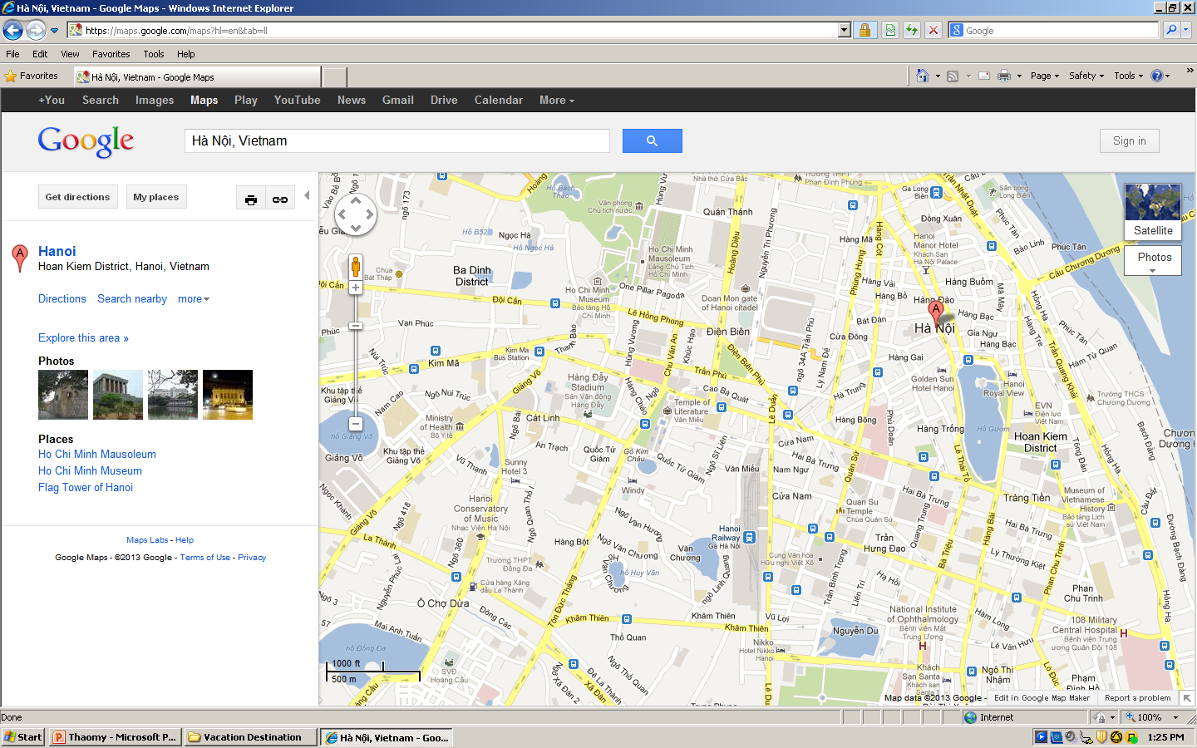
Map

Slide 3
Transportation
Transportation | Budget
Airfare x (family) | $6772.00
Airfare Parking at Airport | $50.00
Car Rental | $0.00
Gas (going) [price x 25/ MPG] | $0.00
Gas (coming home) [price x 25/ MPG] | $0.00
Bus Tickets | $0.00
Train | $0.00
Other | $0.00
Total | $0.00
Figure out gas:
Find miles (google Maps)
Divide miles by 25
Take that number x gas price

Slide 4
Lodging
Lodging | Budget
Hotels $39 x 6how many nights Splendid Star Suite Hotel Not staying in the same place? Sunday Monday Tuesday Wednesday Thursday Friday Saturday | $234
Other | $0.00
Total | $234

Slide 5
Extra Expense
Extra expenses | Budget
Souvenirs ($10x 4of people) x # of purchases | $40
Snacks ($4 x #4of people) x # of purchases | $96
Emergency cash | $125
Total | $261

Slide 6
Itinerary
Total Expense: $56.00
Saturday, June 8th | Where | How Much?
Breakfast | McDonald | $28.00
Activity | Travel | $0.00
Lunch | plane food | $0.00
Activity | travel | $0.00
Dinner | McDonald | $28.00
Activity | Unpack, sleep | $0.00

Slide 7
Itinerary
Total Expense: $0.00
Sunday, June 9th | Where | How Much?
Breakfast | Hotel | $0.00
Activity | Duong lam | $4.00
Lunch | Luc Bat Restaurant . | $30.00
Activity | Duong lam | $4.00
Dinner | Hotel | $0.00
Activity | Sleep | $0.00

Slide 8
Itinerary
Total Expense: $0.00
Monday, June 10th | Where | How Much?
Breakfast | hotel | $0.00
Activity | Hanoi kid tour | $20.00
Lunch | Hotel | $0.00
Activity | Hanoi zoological | $16.00
Dinner | hotel | $0.00
Activity | Sleep | $0.00

Slide 9
Itinerary
Total Expense: $0.00
Tuesday, June 11th | Where | How Much?
Breakfast | Hotel | $0.00
Activity | SF spa | $20.00
Lunch | Hotel | $0.00
Activity | Vietclimb | $30.00
Dinner | Hotel | $0.00
Activity | sleep | $0.00

Slide 10
Itinerary
Total Expense: $0.00
Wednesday, June 12th | Where | How Much?
Breakfast | hotel | $0.00
Activity | Hanoi group tour | $10.00
Lunch | Kem Fanny | $40.00
Activity | Hiking Vietnam day trip | $0.00
Dinner | Hotel | $0.00
Activity | sleep | $0.00

Slide 11
Itinerary
Total Expense: $0.00
Thursday, June 13th | Where | How Much?
Breakfast | Hotel | $0.00
Activity | Grocery shop | $60.00
Lunch | Hotel | $0.00
Activity | Visit great grandmother | $0.00
Dinner | Hotel | $0.00
Activity | sleep | $0.00

Slide 12
Itinerary
Total Expense: $0.00
Friday, June 14th | Where | How Much?
Breakfast | hotel | $0.00
Activity | Take a stroll | $0.00
Lunch | Lac but restaurant | $0.00
Activity | The bookworm Hanoi | $60.00
Dinner | hotel | $0.00
Activity | sleep | $0.00

Slide 13
Itinerary
Total Expense: $332.00
total
Saturday, June 15th | Where | How Much?
Breakfast | McDonald 7x4=28 | $28.00
Activity | travel | $0.00
Lunch | Plane food | $0.00
Activity | travel | $0.00
Dinner | McDonald 7x4=28 | $28.00
Activity | Unpack, sleep | $0.00

